Slide 1
Learning Objectives:
Today
Continue our discussion of public opinion
b. Mood Swings or Pragmatism?
c. America’s Knowledge Gap
Identify the shifts in public opinion since WWII
Describe the trends in the sources of news and information regarding US Foreign Policy
Friday
Role of group identities in opinion formation
A look at peoples’ psychological attachment to the nation and foreign policy (Herrmann reading on Canvas)

Slide 2
Mood Swings or Pragmatism?
Debate over public intellect regarding foreign affairs
Long history of public being viewed as ignorant and uninterested in foreign affairs (and also having “mood swings”)—the “apathy problem”
Almond–Lippmann consensus based on Gallup polls during the late 1940s and 1950s
Public opinion is . . .
Volatile: Shifting on each issue
Incoherent: Lacking reason, roots, and principles
Irrelevant: Policy makers are detached from and tend to ignore public opinion
Notes:
Learning Objective number: 7.1

Slide 3
Mood Swings or Pragmatism?
Almond-Lippman consensus challenged by more recent research detecting more coherence and consistency
Support for multilateral cooperation
Most favor internationalist foreign policy
More protectionism/nationalism on economic issues
Real question today: Should the United States pursue militant internationalism or cooperative internationalism?
Is there another question we should ask in 2019?
What is public opinion?
At its core, it is the belief systems of individuals whose normative values and presumptions about human nature, the state, and society shape their judgments about foreign policy.
Notes:
Learning Objective number: 7.1
The second point overlaps with what distinction?

Slide 4
Mood Swings or Pragmatism?
Public offers reasoned responses based on values, perceptions, and experiences
Level of international trust
Case-by-case basis
Varies by issue area, such as military vs. economic foreign policies
Political party stances and influences
Latent public opinion or ingrained sets of values and methods of evaluating the world can lead to a “pretty prudent public”
React to situations on a logical basis, such as casualties in war
Notes:
Learning Objective number: 7.1

Slide 5
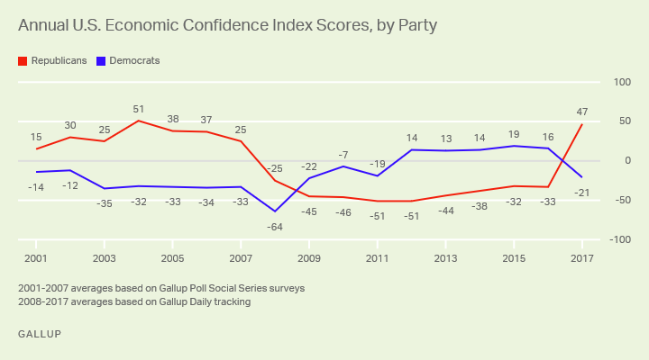
Mood Swings or Pragmatism?

Slide 6
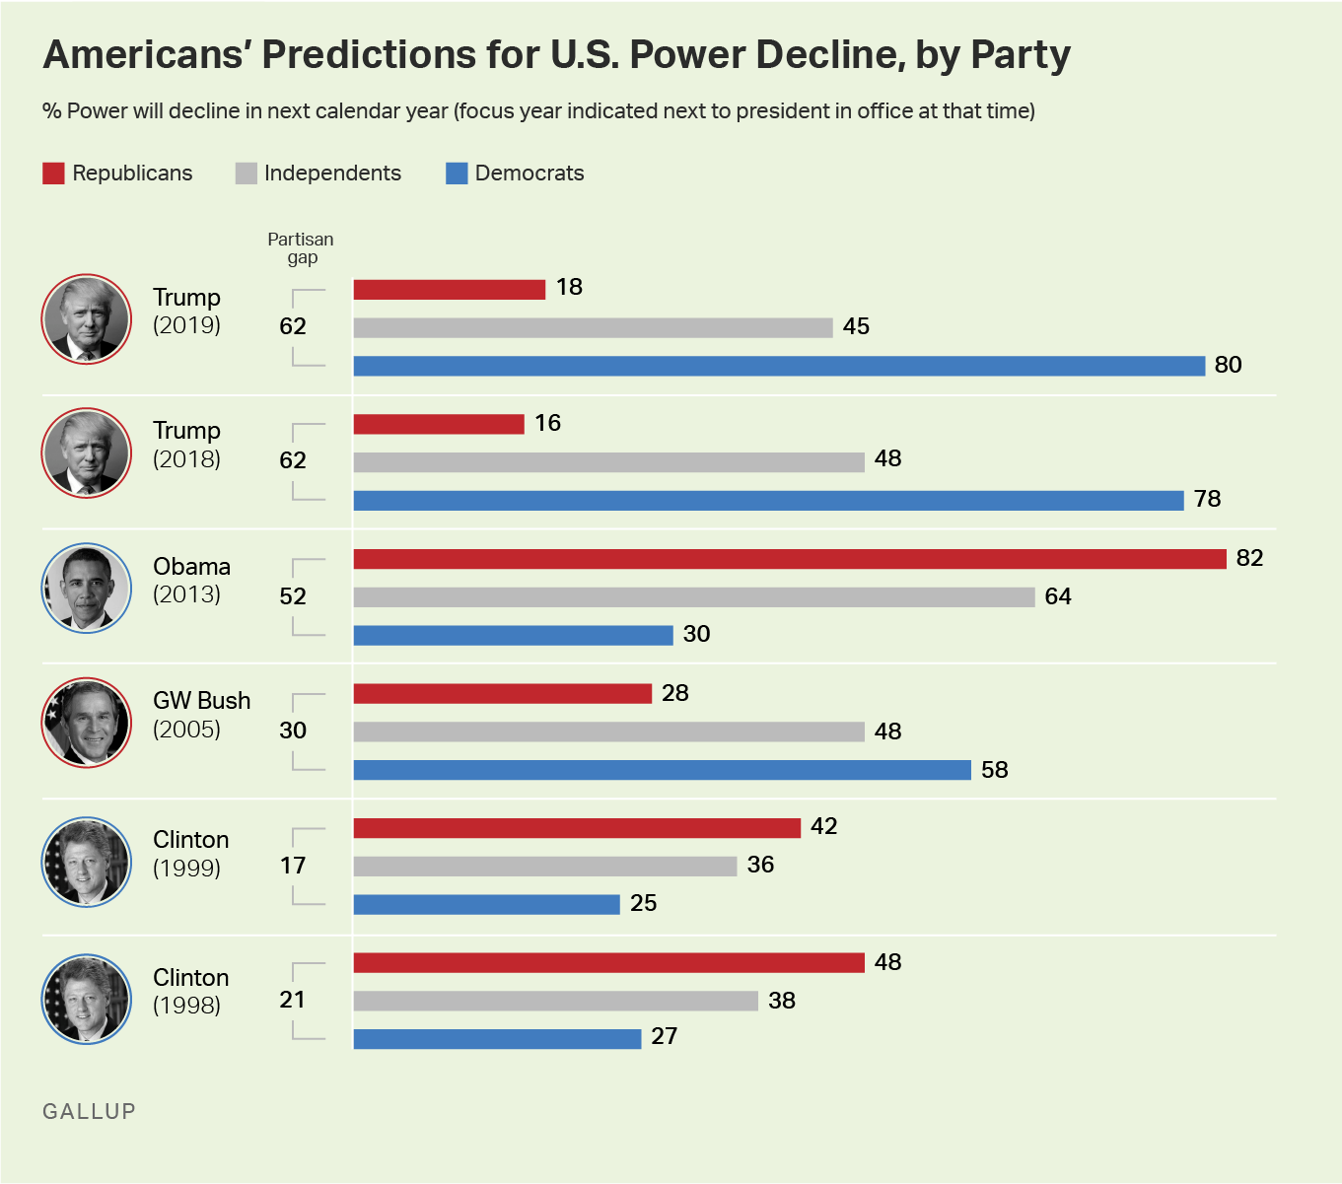
Americans’ view on U.S. World Power

Slide 7
Americas Knowledge Gap
U.S. citizens are poorly informed about the world
Cultural detachment in geography and political culture
U.S. educational system focused on American history and government, not global history and politics
U.S. citizens have trouble identifying countries on maps and naming foreign leaders
Critical knowledge gaps also persist among members of the foreign policy elite.
Notes:
Learning Objective number: 7.1

Slide 8
Question:
Do you think Vermont Senator and Presidential Candidate Bernie Sanders is a hypocrite?
A. Yes
B. No
C. Don’t know

Slide 9
Public Opinion Since World War II
Major challenge post–WWII: Sustaining support for active foreign policy
Public support for containing communism during Cold War
Extended support for Truman during Korean War
Buildup and changes in armed forces under Eisenhower and Kennedy
Early support for Vietnam War under LBJ
Notes:
Learning Objective number: 7.2

Slide 10
Consensus and Discord during the Cold War
Discord began during Vietnam War, based on news coverage, economy, civil rights movement and protests, large losses of life, and Nixon administration
Vietnam Syndrome developed: U.S. public does not favor military intervention unless completely necessary
Carter presidency focused on international human rights and democracy but was plagued by world events and Iran hostage situation
Reagan found support for defense buildup but lost support for interventions based on problems in Central America
George H. W. Bush used strong and quick military for Persian Gulf War with Iraq—fast war pleased public and Bush questioned Vietnam Syndrome
Notes:
Learning Objective number: 7.2

Slide 11
Public Ambivalence in the “New World Order”
After Cold War, public and government had considerable ambivalence regarding foreign affairs
No definite positions or consensus on issues
Public identified “don’t know” as biggest foreign policy problem
Attention focused on economic growth
Lack of grand strategy by Clinton administration (throughout the 1990s)
Public against interventionism, but in favor of multilateral diplomacy, UN efforts, and Foreign Aid
Notes:
Learning Objective number: 7.2

Slide 12
Rally around the Flag after 9/11
Public concerns about terrorism, security, and the Middle East after 9/11 attacks
Public rallies around the president and other officials during times of crisis
Diversionary theory of war: Suggests that officials can benefit from crises and sometimes even desire them
Bush’s approval rating jumped following 9/11: Peaked at highest rating enjoyed by any president
Public, in turn, supported antiterrorism (U.S. PATRIOT Act)
Public granted early approval of Afghanistan invasion
Notes:
Learning Objective number: 7.2

Slide 13
The Anti-American Backlash
2001–2007
From 2001 to 2006, U.S. public approval of Bush fell from high of 90% to 30%
In 2005, 90% of Americans polled thought showing more respect for the views and needs of other countries would increase security
In 2006, citizens in 33 of 35 countries perceived terrorism was more likely
In 2007, approximately 2 out of 3 Americans thought the war in Iraq was not going well
Still, the U.S. continued to receive support from the Philippines, Japan, and Eastern Europe
Notes:
Learning Objective number: 7.2

Slide 14
Foreign Policy Renewal & Fatigue in the Obama Era
New priorities in 2008
Top priority for Americans was improving America’s world standing
Next two priorities: Jobs and access to energy
Obama’s foreign policy agenda
(1) Diplomacy; (2) Multilateral cooperation; (3) International law; (4) International institutions.
Recent developments fuel public’s sense of foreign policy fatigue
Arab Spring
Power plays by Russia, China
Rise of the Islamic State
Notes:
Learning Objective number: 7.2

Slide 15
What do Americans really want?
A prevalent contradiction in the way that public opinion interacts with U.S. foreign policy:
While most Americans favor international withdrawal and a focus on domestic issues, a majority (56%) also believes that the Obama administration did not do enough to fight the Islamic State, and that American standing and power in world affairs are important.
What to do about that?

Slide 16
The View from Overseas
Growing impact of international public opinion
Advanced technologies
Widespread growth of civil societies in response to domestic reforms
Transnational issues
2012: Upswing in international public support for U.S.
Better perceptions of U.S. in European countries, China, Japan, Mexico
Negative majorities remain in Middle East, Turkey, Russia
2016: Major down-turn since advent of Trump administration
Notes:
Learning Objective number: 7.2

Slide 17
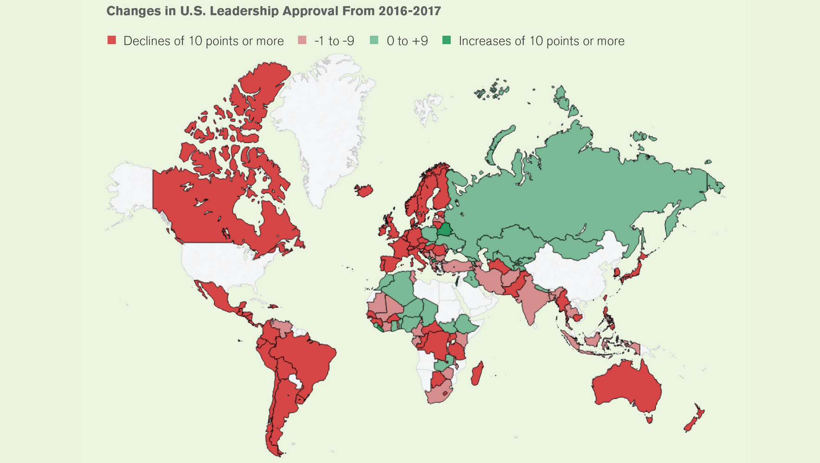
Should we care about U.S. global approval rating?

